Slide 1


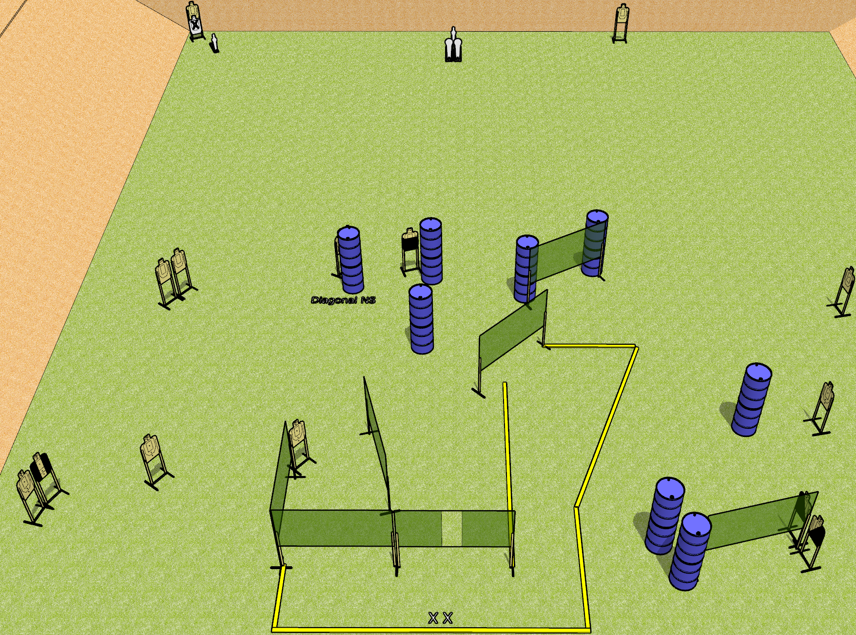
 | Dothan Gun Club – USPSA Match Mom’s Spaghetti Course Designer : Drew Coleman
Round Count 32 rounds 14 USPSA targets 2 colt poppers, 2 USPSA mini poppers
Equipment List 12 wall feet 2 Tuxedos, 1 left diagonal, 1 right diagonal, 1 50%

Slide 2
Mom’s Spaghetti
Written Stage Briefing
Mom’s Spaghetti is a 32 round, 160 point, Comstock field course. There are 14 USPSA targets, 2 colt poppers, and 2 USPSA mini poppers. The best 2 hits on paper will score, and steel must fall to score. The start signal is audible.
Handgun start position is both feet on X’s, wrists below belt. Handgun is loaded and holstered.
PCC start position is both feet on X’s. Loaded carbine is held with both hands, stock on belt, safety on.
On start signal, engage targets as they become available from within the shooting area.

